Slide 1

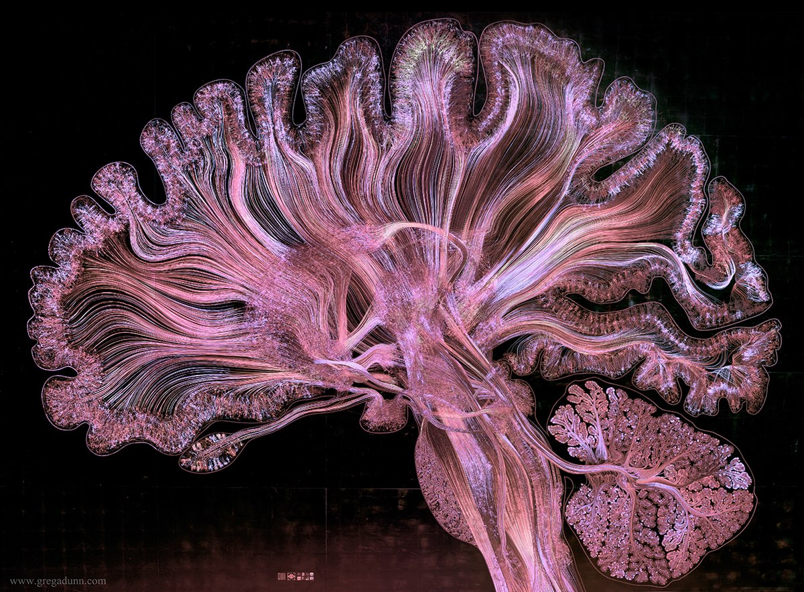
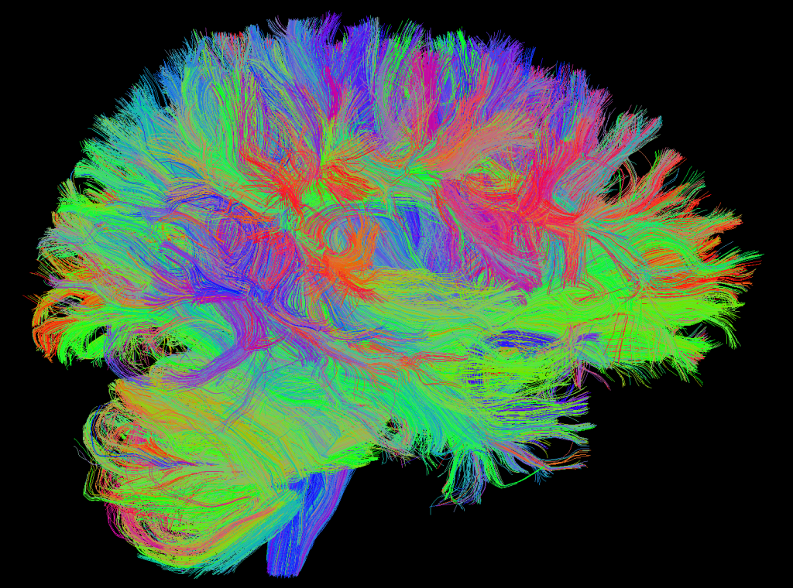
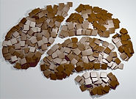

Exploring Compositionality in the Brain
James Campbell
CoCo Lab
Cornell University
Spring 2022

Slide 2
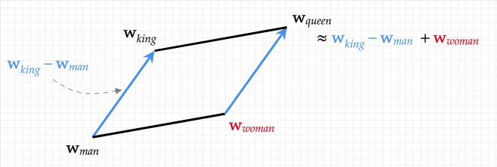
Background: Word Embeddings

Slide 3
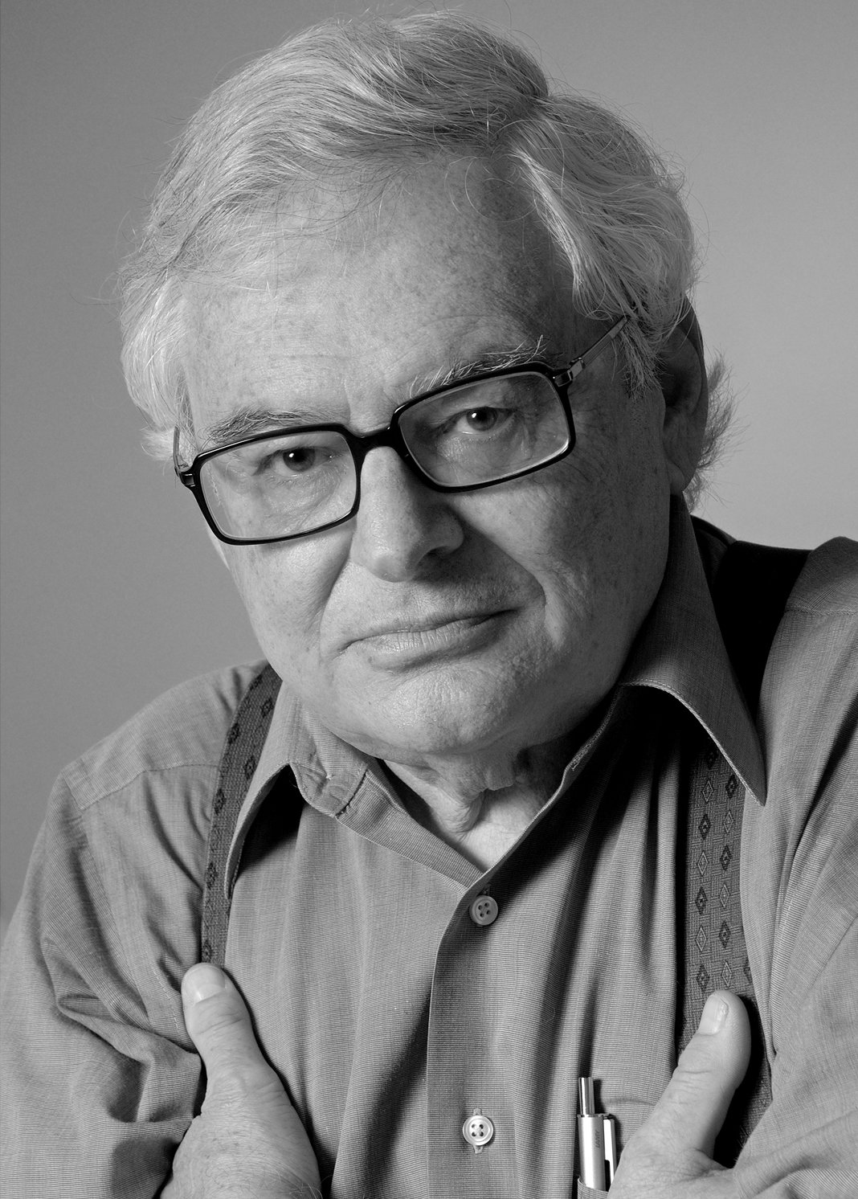
Background: Philosophy of Mind
“Within the family of theories that identify concepts with mental representations, there is a more or less explicit consensus that concepts are productive, and that their productivity is explained by the assumption that mental representations (MRs) are compositional. We will assume…that some version of this story is correct.”
--Jerry Fodor

Slide 4
Background: Philosophy of Mind
“Within the family of theories that identify concepts with mental representations, there is a more or less explicit consensus that concepts are productive, and that their productivity is explained by the assumption that mental representations (MRs) are compositional. We will assume…that some version of this story is correct.”
--Jerry Fodor
My question:
Can we observe (through neuroimaging) additive compositionality among the brain’s semantic representations?

Slide 5
Existing Work
“Concepts and Compositionality: In Search of the Brain’s Language of Thought”
Most work looking in the domain of linguistics (especially relations)
Focus on the default mode network and specific sub-areas and processes (grid cells)
Lexical stimuli, various modalities
Comparatively old (pre-2012)

Slide 6
Existing Work
“Concepts and Compositionality: In Search of the Brain’s Language of Thought”
Most work looking in the domain of linguistics (especially relations)
Focus on the default mode network and specific sub-areas and processes (grid cells)
Lexical stimuli, various modalities
Comparatively old (pre-2012)
My project:
Data-driven, whole brain
Visual representations
Large-scale, high-resolution fMRI (Natural Scenes Dataset)

Slide 7
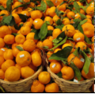
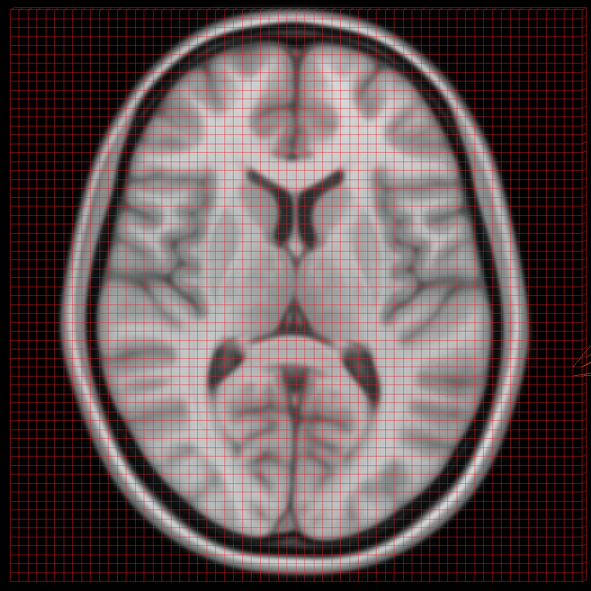
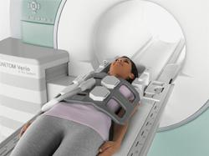
Dataset: NSD
Meta-data includes captions (“several baskets of oranges”) and labels (‘orange’: 26, ‘basket’: 2)

Slide 8
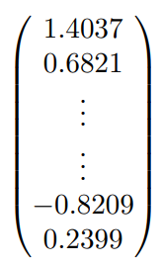
Semantic representations from averaging
For each image with an exclusive label (e.g. ‘orange’), average the responses, leaving—hopefully—the semantic representation of that concept!

Slide 9
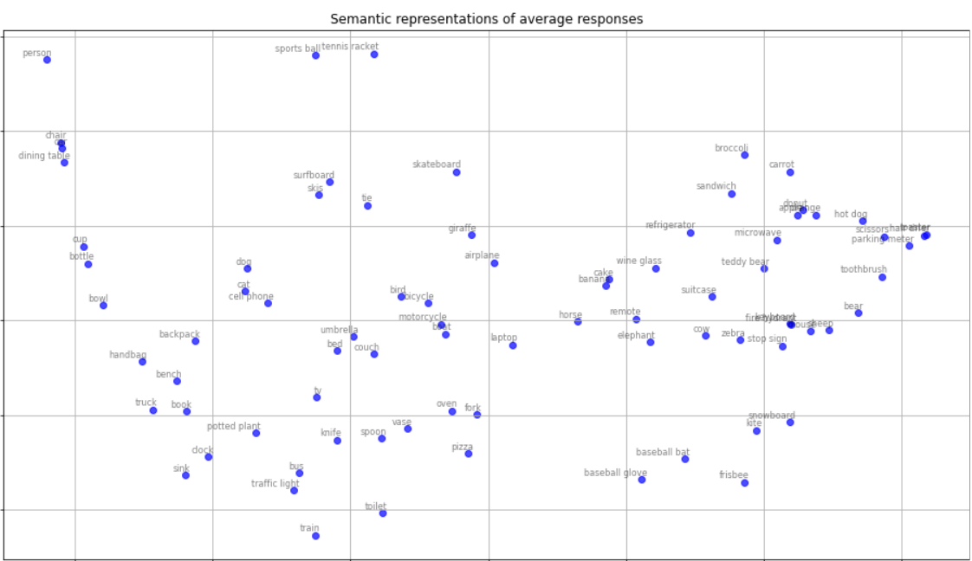
Semantic representations from averaging

Slide 10
Nearest neighbor search
1
‘apple’ + ‘banana’
……
30,000

Slide 11
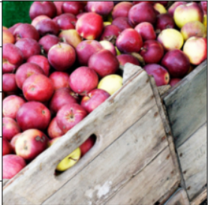
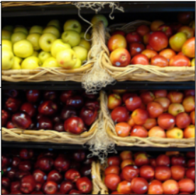
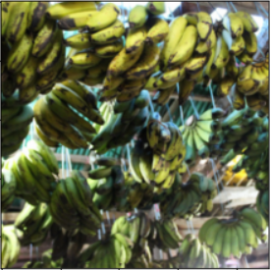
Nearest neighbor search
Top 5
1
‘apple’ + ‘banana’
……
30,000

Slide 12
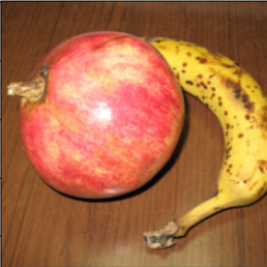
Nearest neighbor search
Top 5
1
‘apple’ + ‘banana’
……
Misses:
30,000

Slide 13
Multi-label averages
For each image with two specific labels (e.g. ‘apple’ and ‘banana’) that both appear in the caption (“an apple and a banana sitting on a table”), average the responses, leaving—hopefully—the semantic representation of the composition of concepts!

Slide 14
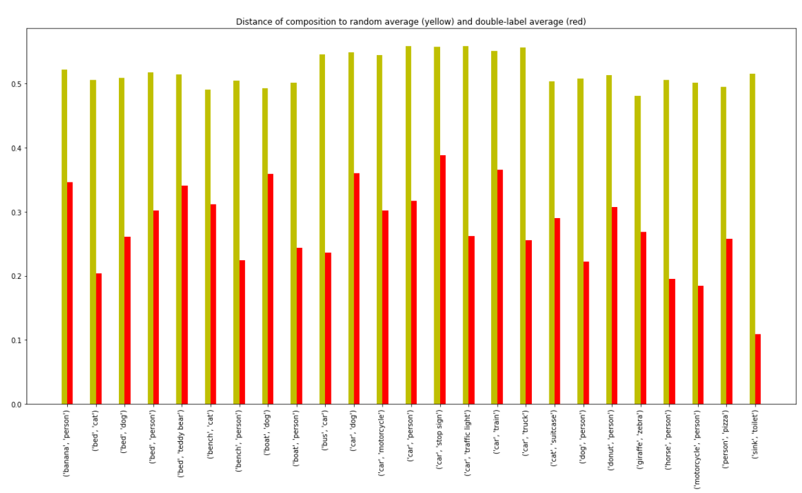
Multi-label averages
dist(label_1 + label_2, labels_1_and_2) < dist(label_1 + label_2, random)

Slide 15
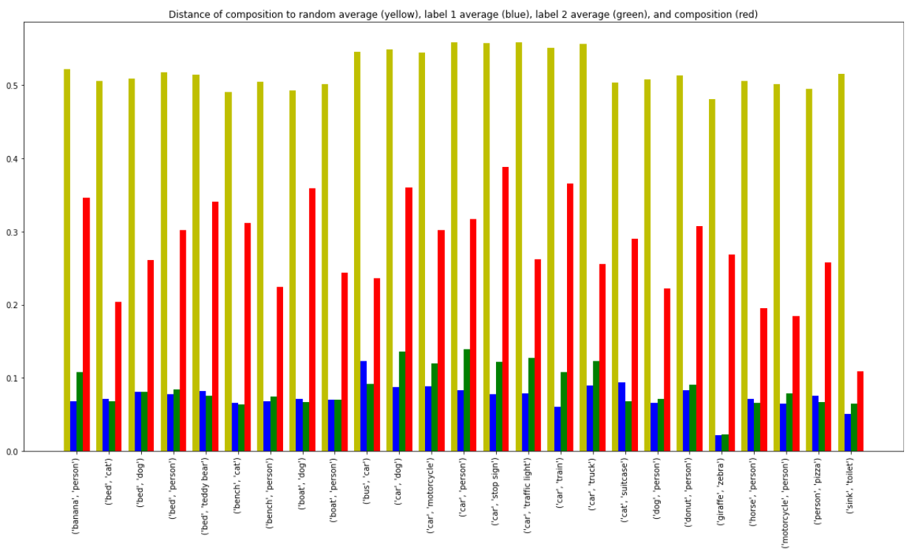
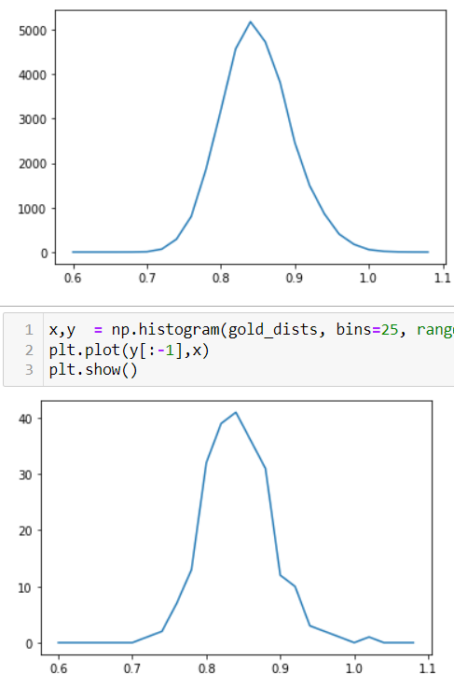
Multi-label averages
dist(label_1 + label_2, label_1) < dist(label_1 + label_2, labels_1_and_2) < dist(label_1 + label_2, random)

Slide 16
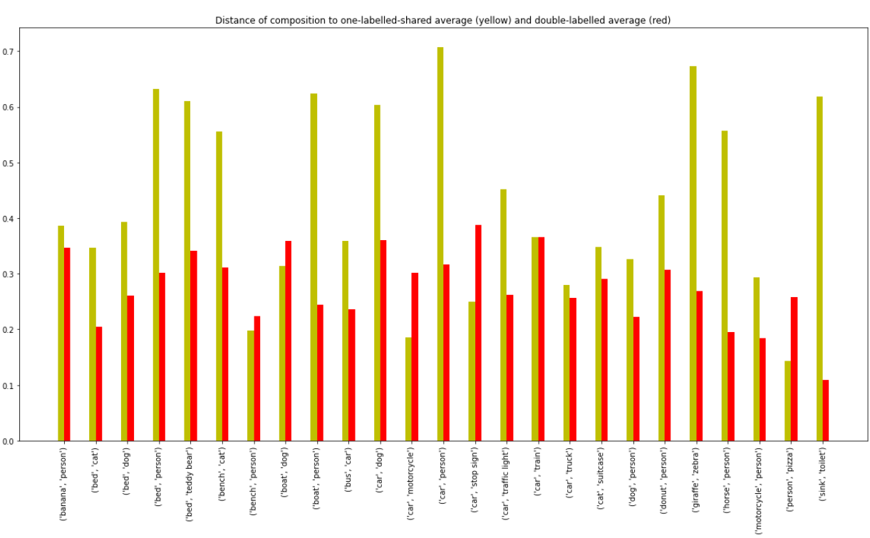
Multi-label averages

Slide 17
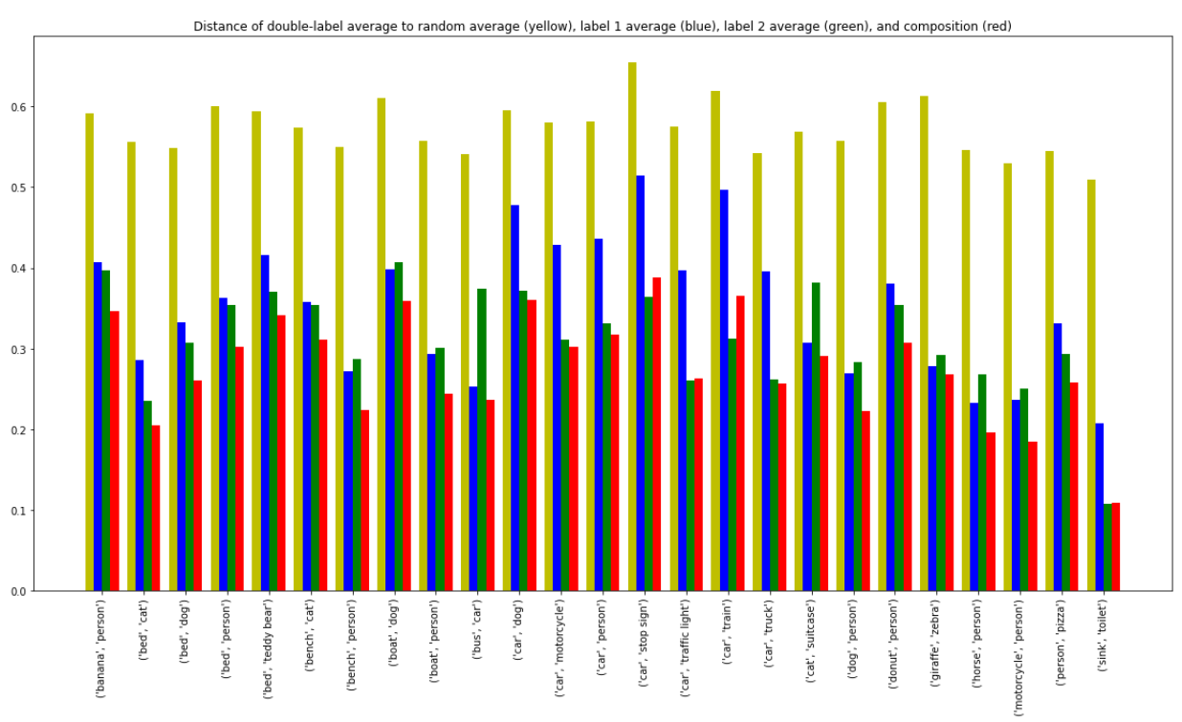
Multi-label averages
dist(labels_1_and_2, label_1 + label_2) < dist(labels_1_and_2, label_1) < dist(labels_1_and_2, random)

Slide 18
Conclusions
Representation of two concepts doesn’t appear to be equal to the sum of the constituents
Two alternatives:
The brain isn’t fundamentally compositional (at least with visual input)
E.g. Thousand Brains theory
Methodology is limited
Averaging along categories doesn’t result in robust semantic maps; not localized enough
Image curation difficulties
Whole-brain, data-driven approach introduces too much noise
Some categories work better than others
Further tinkering will determine if these limitations can be overcome!

